Slide 1

COMFORT KILLERS
Get Uncomfortable
www.thecomfortkillers.com

Slide 2


GET UNCOMFORTABLE NOW!.
I believe that getting uncomfortable is the only way one can reach success. Fear gets in the way of us living powerful lives, one that gets us from point A to point B. I am dedicated to teaching millions how to get uncomfortable. This is a quick course on how to start taking action!
The Comfort Killer,
Stacy
Cross

Slide 3

1. STOP WATCHING T.V
Your television is not making you rich – It’s actually taking away from you reaching your goals and success. Can you call the cable company right now and have them cancel it? Do it RIGHT NOW!

Slide 4

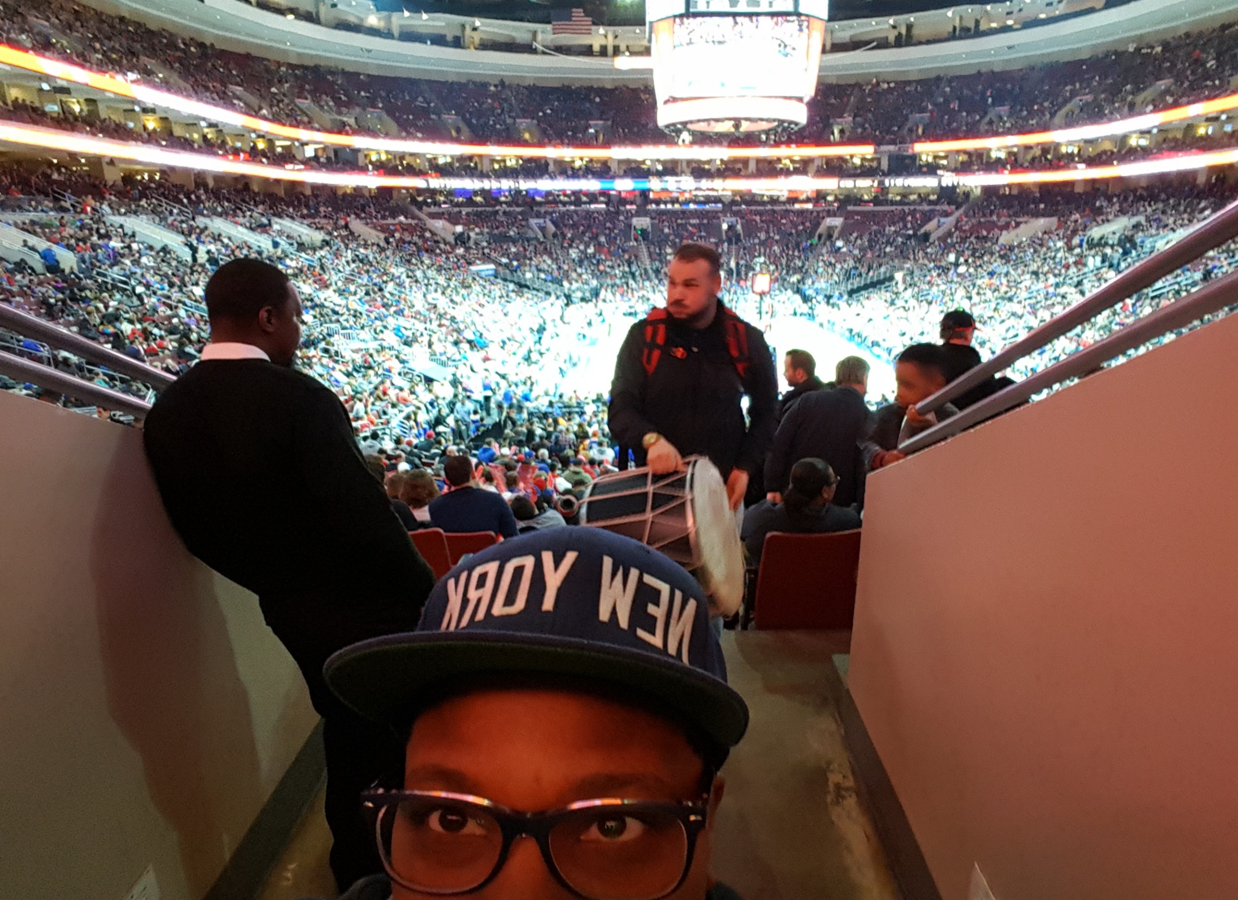
2. TAKE A WALK
The universe is waiting for you to change, grow and create a better life. Go take a walk and think about the life that you want to create. Nature welcomes you and gives you creative ways to do it!

Slide 5

3. READ A BOOK
Great individuals have left clues of easier ways to change your life. These clues can be found in books. If you don’t like reading, good – then listen to an audio book. Gain as much knowledge – take success!

Slide 6

4. WRITE YOUR GOALS
Write down your top 3 goals right now. Make them ultra scary, make them almost sound impossible to anyone reasonable. The first step to getting uncomfortable is to punch fear in the face – DO IT!

Slide 7

5. GET A TUTOR
You need to learn how to be a student again. Why don’t you get off your ass and learn something new. Hated math in school? Go get a math tutor. Learn to play the piano. Learn a language, get excited again!

Slide 8

6. TAKE A COURSE
Stack your knowledge up. I used to never know how to write code and I still suck pretty bad but now I know more than I did before. There are FREE courses online waiting for you to explore. So what you suck now.

Slide 9

7. CALL AN OLD FRIEND
You need to get uncomfortable in ways you never thought of before. Calling an old friend or family member will force you to speak about what your working on and allows you to focus on communication!

Slide 10

8. WRITE AN ENTRY
You need a journal, killer! You need to start writing today! Write about anything…birds, pizza, your goals. Write until the real you starts to unfold and your true value blossoms. DO IT!

Slide 11

9. GO HAVE DINNER
Go have dinner or lunch BY YOURSELF. Treat yourself to a day for yourself and by yourself. We always seem to need the comfort of other people around us and this tactic will crush that because it will get tough!

Slide 12

10. CREATE A WEBSITE
Start a blog or website, its free. You need something to do with the time your saving from not watching TV. Starting a blog will make you a creator. You will create meaningful content that brings value.

Slide 13
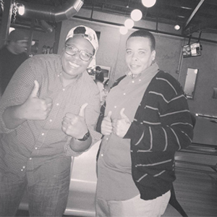
TESTIMONY
Debbie Williams, 34 years old. A friend and a person who is coached by me. The value that I receive from training and awakening souls is by far the best experience ever. Just recording this testimony with her increases my willingness to do more and be a better friend. She seen me at my worst and now she has the opportunity to see me at my best and work with millions of people across the globe. Debbie currently lives with me so she is able to get my teachings first hand and I am happy to constantly give her the highest quality just as I would give you! I want to help reshape your life, so you can think better, act better and live better. – Stacy
Debbie Williams

Slide 14



ARE YOU A COMFORT KILLER YET?
Download The Comfort Killers Book
FREE GIFT FOR YOU!
I wrote the comfort killers handbook in 1 day. I was absolutely killing it that day. I made the decision that I needed a product and then my fingers started to move and before you know it, I wrote 20,000 words. This eBook is my free give to you for taking the necessary action to getting right where you need to be! Right here!

Slide 15


Now, Let’s Talk About
YOU!
Stacy@TheComfortKillers.com
267.90(STACY)
Twitter : Facebook

